Slide 1
Linguistics 200, Weeks 9-10
Verbs

Slide 2
Last Time
Nominals:
Number, Gender, Case
Adjectives
Pronouns

Slide 3
For the next 2 weeks: Verbs
Monday, Wednesday: In person class
Friday: work at home, or in groups on component 3
Make sure that you’ve got your nominals done
Have game plan for: person, number, tense, aspect
Friday: I'm in LA
Next Monday: Fall Break
Next Wednesday, Friday:
more verbs

Slide 4
Today: Creating your Verbal System
Information Encoded in Verbs
Person
Number
Valency
Mood
Voice
Aspect
Tense
** Key Takeaway **
NONE of these things have to be encoded in the verbs, but they do have to be marked somehow.

Slide 5
Person
Consider the following sentences.
I sleep.
You sleep.
He/she/it sleeps.
We sleep.
Y’all sleep.
They sleep.

Slide 6
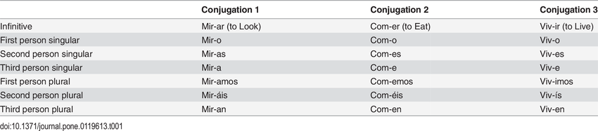
Person

Slide 7
Person
Some noun phrase or pronoun is ENCODED within the verb.

Slide 8
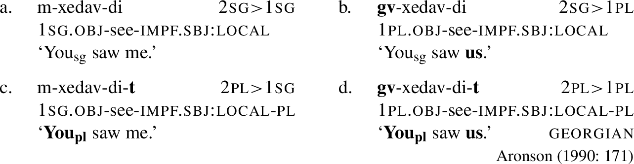
Beyond subjects: Georgian

Slide 9
Person - Mɤɧøɴ
Like Georgian, but no case. Subject + object + verb

Slide 10
Person Markers
We made these for our nominal system
sg. du. pl.
1 kɤ kuu kaa
2 ku kuu kwa
“metra” o ow oa
“animal” ʀɤ ʀuu ʀaa
“plant” sø suu saa
“it” ta taw taa

Slide 11
Person
“I drink” kɤʛu “I drink it.” kɤtaʛu
“You drink” kuʛu “You drink it.” kutaʛu
“It (met.) drinks” oʛu “It drinks it.” otaʛu

Slide 12
Person
No subject pronoun needed if noun specified:
taʛu çampa. “Chomper drinks it.”
kaaɴaɴ we. “The dinosaur bites us.”
No object pronoun need if noun specified:
kɤʛu men. “I drink water.” not *kɤtaʛu meɴ.

Slide 13
Number
Remember this?

Slide 14
Number: Singular & Plural

Slide 15
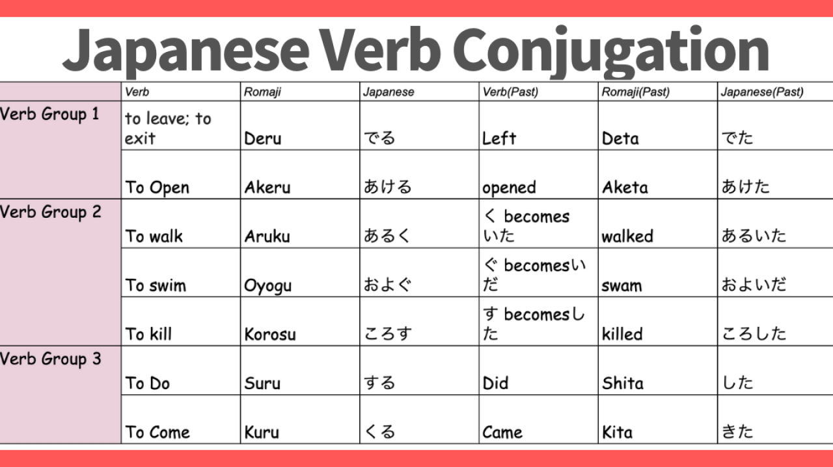
Number: Unmarked

Slide 16
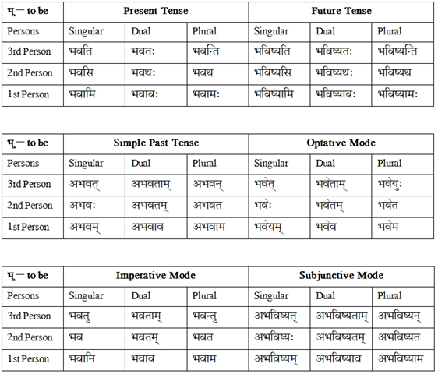
Number: Singular, Plural, and Dual

Slide 17
Number
Your verbs should not have more numbers than your nominal system; but you can have overt number in your noun system but not in your verbs.

Slide 18
Number - Mɤɧøɴ
Already had established 3 in the noun system - singular, dual, plural

Slide 19
The Mɤɧøɴ Pronouns
sg. du. pl.
1st person kɤ kɤɠu kɤka
2nd person ku kuɠu kuka
3rd person (met) o oɠu oka
(animal) ʀɤ ʀɤɠu ʀɤka
(plant) sø søɠu søka
(other) ta taɠu taka

Slide 20
Person Markers
sg. du. pl.
1 kɤ kuu kaa
2 ku kuu kwa
“metra” o ow oa
“animal” ʀɤ ʀuu ʀaa
“plant” sø suu saa
“it” ta taw taa
How did I arrive at these?

Slide 21
Person Markers
du. pl.
1st person kɤɠu kɤka
2nd person kuɠu kuka
3rd person (met) oɠu oka
(animal) ʀɤɠu ʀɤka (plant) søɠu søka (other) taɠu taka
du. pl.
kuu kaa
kuu kwa
ow oa
ʀuu ʀaa
suu saa
taw taa
What changed?

Slide 22
What to do with Dgon?
Numbers (4): sg., du., pl. paucal
Genders (2): natural – animate, inanimate
Cases (8): grammatical & prepositional (oblique)
Adjectives: incorporated (compounded within Ns)
Pronouns: 4 numbers, 2 genders, prefixed cases

Slide 23
Activity – Dorgon pronoun system
Let’s create a table of pronouns with 1, 2, 3 on the left side. Include along the top the numbers you’ve posited for your language.
 | sg. | du. | pl. | paucal
1 | do ‘I’ | kto ‘we 2’ | ekto ‘we’ | akto ‘a few of us’
2 | ço ‘you’ | kço ‘you 2’ | ekço ‘y’all’ | akço ‘a few of y’all’
3 anim. inanim. | a ‘they’ un ‘it’ | ke: ‘they 2’ kew ‘they 2’ | eke: ‘they (pl.)’ ekew ‘they’ | ake: ‘a few of them’ akew ‘a few of them’

Slide 24
Pronouns – need to reflect case, too!
a ‘they (sg.)’
subject pfodpθ̩mɳa pfa ‘they’
dir. obj. dpθ̩mɳa a ‘them’
indir. obj. udpθ̩mɳa wa ‘to/for them’
‘before’ badpθ̩mɳa ba ‘before them’
‘after’ dadpθ̩mɳa da ‘after them’
‘from’ ikadpθ̩mɳa ika ‘from them’
‘with’ idpθ̩mɳa ja ‘with them’
‘of’ sxdpθ̩mɳa sxa ‘their’
By rule!

Slide 25
Elijah LIKES complicated
kepfodpθ̩mɳgfa ‘2 big idiots (subject)’

Slide 26
Let's incorporate our nominal subjects into the V
kepfodpθ̩mɳgfa ‘2 big idiots (subject)’
tom ‘drink’
e ‘know’

Slide 27
Alright, for Dgon
For your language, grab 3 verbs from your Swadesh list.
“Eat”
“Sleep”
“Give”
As we did with Mɤɧøɴ, arrange the verbs according by:
Person
Number
Translate the following sentences (feel free to change nouns to make more appropriate for your culture):
“I eat.”
“You sleep in the bed.”
“He eats and sleeps a lot.”
“We give you a book.”
“Y’all eat meat.”
“They give the man a fish.”

Slide 28
Okay, your turn!
For your language, grab 3 verbs from your Swadesh list.
“Eat”
“Sleep”
“Give”
As we did with Mɤɧøɴ, arrange the verbs according by:
Person
Number
Translate the following sentences (feel free to change nouns to make more appropriate for your culture):
“I eat.”
“You sleep in the bed.”
“He eats and sleeps a lot.”
“We give you a book.”
“Y’all eat meat.”
“They give the man a fish.”

Slide 29
Linguistics 200, Weeks 9-10
Verbs

Slide 30
Last Time:
Person
Number

Slide 31
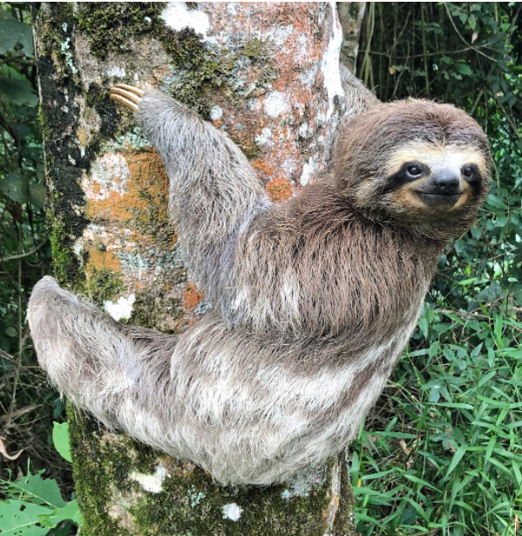
But how do you create markers for your language?

Slide 32
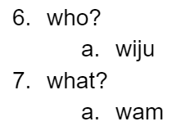
Creating markers for your language - Sruɗɞr
What do both interrogative words have in common?

Slide 33
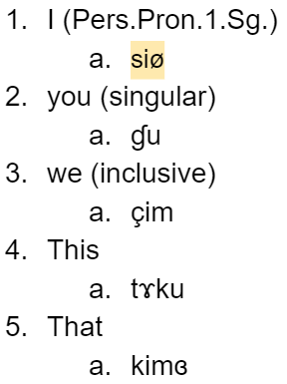
Creating markers for your language - Sruɗɞr
1st person?

Slide 34
Creating markers for your language - Sruɗɞr
2nd person plural?

Slide 35
Creating markers for your language - Sruɗɞr
3rd person?

Slide 36
Creating markers for your language - Sruɗɞr
3rd person plural?

Slide 37
Okay, your turn!
Translate the following sentences (feel free to change nouns to make more appropriate for your culture):
“I eat.”
“You sleep in the bed.”
“He eats and sleeps.”
“We give you a book.”
“Y’all eat meat.”
“They give the man a fish.”

Slide 38
Tense
Consider the following sentences:
‘I walk to school.’
‘I walked to school.’
‘I will walk to school.’
** What is the difference between these three sentences? **

Slide 39
Explore
Visit https://en.wikipedia.org/wiki/Grammatical_tense; scroll down to “Possible tenses”

Slide 40
Tense - Mɤɧøɴ
Present --
Past
Super past (remote past)
Future

Slide 41
Tense - Mɤɧøɴ
Present (nothing) kɤʛu meɴ. I drink water.
Future (ti) kɤʛuti meɴ. I will drink water.
past (pa) kɤʛupa meɴ. I drank water.
remote past (paa) kɤʛupaa meɴ. I drank water a long time ago.

Slide 42
Aspect
Consider the following sentences:
‘I walked to school.’ past tense (simple past; preterit)
‘I have walked to school.’ perfect
‘I was walking to school.’ past progressive
** What is the difference in meaning between these three sentences? **

Slide 43
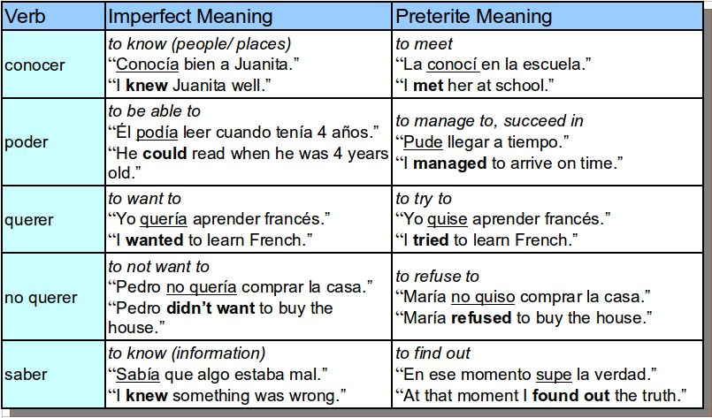
Aspect

Slide 44
Explore
Visit https://en.wikipedia.org/wiki/Grammatical_aspect, scroll down to “By language” & browse the examples of aspect marking

Slide 45
Aspect - Mɤɧøɴ
Like mood, separate words
kɤʛu meɴ. “I drink water.” -- unmarked = indicative
çi kɤʛu meɴ. “I am drinking water.” -- çi ‘now’ + present
ɣun kɤʛupa meɴ. “I have drunk water.” -- ɣun ‘already’ + past

Slide 46
Linguistics 200, Weeks 9-10
Verbs

Slide 47
Today & Friday
Review
Final three verbal categories:
Voice
Valence
Mood
Translation practice

Slide 48
Think back:
What are:
Tense
Aspect
Person
Number

Slide 49
Voice
Consider the following sentences:
I baked a pizza in the oven.
The pizza was baked in the oven.
The pizza baked in the oven.

Slide 50
Voice
Consider the following sentences:
I baked a pizza in the oven. Subject = I, the baker
The pizza was baked in the oven. Subject = The pizza, the baked
The pizza baked in the oven. Subject = The pizza, the baked

Slide 51
Voice
Consider the following sentences:
I baked a pizza in the oven. Active - subject focused
The pizza was baked in the oven. Passive - object focused in subject
The pizza baked in the oven. Middle - in between
Common for reciprocals: “We punched each other.”
reflexives: “I punched myself.”

Slide 52
Voice
अहं नरं स्मरामि ahaṃ naraṃ smarāmi I remember the man.
नरः स्मरते naraḥ smarate The man remembers himself.
नरो मया स्मर्यते naro mayā smaryate The man is remembered by me.

Slide 53
Voice - Mɤɧøɴ
Active, Middle, Passive

Slide 54
Voice - Mɤɧøɴ
Active, Middle, Passive
Middle marked by doubling of final syllable of verb (ʛu → ʛuʛu, ʀuɗe → ʀuɗeɗe).
“I drink water.” → kɤʛu meɴ.
“I drink myself.” → kɤʛuʛu.
“I drink me some water.” → kɤʛuʛu meɴ.
“Water is drunk by me.” can’t say this!

Slide 55
Valency
Consider the following sentences:
It’s raining.
It’s sleeping.
It’s hugging the wall.
It’s giving the people candy.
** How many nominals are in each sentence? **

Slide 56
Valency
Consider the following sentences:
It’s raining. = 0
It’s sleeping. = 1 (it)
It’s hugging the wall. = 2 (it, the wall)
It’s giving the people candy. = 3 (it, the people, candy)
** How many nominals are in each sentence? **

Slide 57
Valency
Consider the following sentences:
It’s raining. = avalent
It’s sleeping. = intransitive
It’s hugging the wall. = transitive
It’s giving the people candy. = ditransitive
** How many nominals are in each sentence? **

Slide 58
Valency
In English, we don’t mark for valency
It’s pouring outside. = avalent
It pours well. = intransitive
He pours a drink. = transitive
He pours water on himself. = ditransitive

Slide 59
Valency
Some languages do mark for valency, though. Imagine the following:
poura = avalent
pouru = intransitive
pouri = transitive
pouro = ditransitive

Slide 60
Valency - Mɤɧøɴ
No explicit marking except for ditransitives (the one with 2 objects) “It’s giving the people candy.”

Slide 61
Valency
Insert -n- before verb:
kɤʀuɗe meɴ “I give water.” (generally) → kɤkunʀuɗe meɴ “I give you water.”
If both subject and object are specified nouns, the correct gendered pronoun will be used, followed by -n.
ʀuɗe çampa meɴ. “Chomper gives water” (generally) →
ʀɤnʀuɗe çampa meɴ we. “Chomper gives water to the dinosaur.”
onʀuɗe çampa meɴ iɴ. “Chomper gives water to the metra.”
sønʀuɗe çampa meɴ ɓiŋ. “Chomper gives water to the seaweed.”

Slide 62
Mood
Consider the following sentences:
I am a fish, and I like to eat fish food.
Were I a fish, I would eat fish food.
Be a fish! Eat fish food!
Am I a fish? Do I eat fish food?
** What is the purpose of each sentence? **

Slide 63
Mood
Consider the following sentences:
I am a fish, and I like to eat fish food. = Statement
Were I a fish, I would eat fish food. = Hypothetical
Be a fish! Eat fish food! = Command
Am I a fish? Do I eat fish food? = Question
** What is the purpose of each sentence? **

Slide 64
Mood
Consider the following sentences:
I am a fish, and I eat fish food. = Statement
Were I a fish, I would eat fish food. = Hypothetical
Be a fish! Eat fish food! = Command
Am I a fish? Do I eat fish food? = Question
** How is each mood expressed? **

Slide 65
Mood
In Latin:
Pisces sum. Cibum edo. = Statement
Pisces sim, cibum edam. = Hypothetical
Es pisces! Ede cibum! = Command
Pisces sum? Cibum edo? = Question
** How is each mood expressed? **

Slide 66
Mood - Mɤɧøɴ
Different word orders?
Different words?
New words that indicate mood?

Slide 67
Mood - Mɤɧøɴ
Has helping verbs for hypothetical (na), question (ɓu); no subject specified for imperative. Helping verbs placed before verb and prefixes.
kɤʛu meɴ. “I drink water.”
na kɤʛu meɴ. “Were I to drink water…”
ʛu meɴ! “Drink water!”
ɓu kɤʛu meɴ? “Am I drinking water?”

Slide 68
Linguistics 200, Weeks 9-10
Verbs

Slide 69
Putting it all together...
You now have the strategies to address the following seven categories for verbs in language:
Person
Number
Valency
Mood
Voice
Tense
Aspect

Slide 70
Dgon Verbs
Person: no marker; pronoun/subj. required (except for avalent)
Number: no marker, pronoun/subj. required (except for avalent)
Tense: non-future: no marker; future: tx-
Aspect: no contrast
Voice: only active
Valency: only marker to increase: mo- (immediately before root)
co ‘sleep’ → moco ‘make sleep; bore’
dipθ ‘be confused; be ignorant’ → modipθ ‘confuse; befuddle’
Mood: prefix; hypothetical: sn-; imperative: omit subject marker

Slide 71
Dgon Verbs
Order of prefixes: TA + mood + valency + root
tx-sn-mo-di-gizi-pθ pfa
FUT-HYPO-VAL-‘be.confused’< ‘Gzenian (ACC)’ >
‘they (sg.) might confuse the Gzenian (in the future)’

Slide 72
Let’s begin by translating the following sentences
 | ^{sg.} | ^{du.} | ^{pl.} | ^{paucal}
¹ | ^{do} ^{‘I’} | ^{ke-do} ^{‘we 2’} | ^{eke-do} ^{‘we’} | ^{ake-do} ^{‘a few of us’}
² | ^{ço} ^{‘you’} | ^{ke-ço} ^{‘you 2’} | ^{eke-ço} ^{‘y’all’} | ^{ake-ço} ^{‘a few of y’all’}
^{3 anim.} ^{inanim.} | ^{a ‘they’} ^{un ‘it’} | ^{ke:} ^{‘they 2’} ^{kew} ^{‘they 2’} | ^{eke:} ^{‘they (pl.)’} ^{ekew} ^{‘they’} | ^{ake:} ^{‘a few of them’} ^{akew} ^{‘a few of them’}
‘He drinks’
‘I drink.’
‘They drink.’
‘They drink water.’
‘Drink water!’
‘If I drink water...’
​
subject pfodpθ̩mɳa pfa ‘they’​
dir. obj. dpθ̩mɳa a ‘them’​
indir. obj. udpθ̩mɳa wa ‘to/for them’​
‘before’ badpθ̩mɳa ba ‘before them’​
‘after’ dadpθ̩mɳa da ‘after them’​
‘from’ ikadpθ̩mɳa ika ‘from them’​
‘with’ idpθ̩mɳa ja ‘with them’​
‘of’ sxdpθ̩mɳa sxa ‘their’ ​
​
tom ‘drink’
tso ‘lava’

Slide 73
For your language...
‘He drinks’
‘I drink.’
‘They drink.’
‘They drink water.’
‘Drink water!’
‘If I drink water...’

Slide 74
Putting it all together...
You now have the strategies to address the following seven categories for verbs in language:
Person
Number
Valency
Mood
Voice
Tense
Aspect

Slide 75
Okay, your turn!
Translate the following sentences:
“I eat (every day).”
“I am eating.”
“You ate (yesterday).”
“He/she/it was eating (yesterday).”
“They ate (a long time ago).”
“The fish was eaten.”
“The snake ate itself.”

